Slide 1

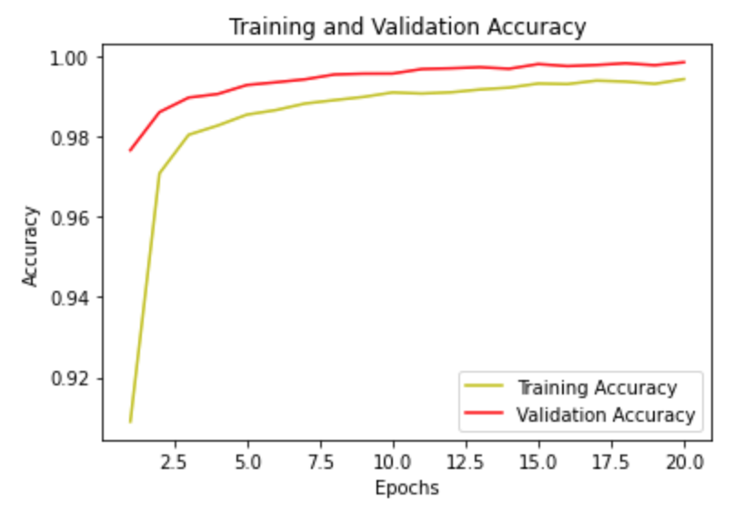
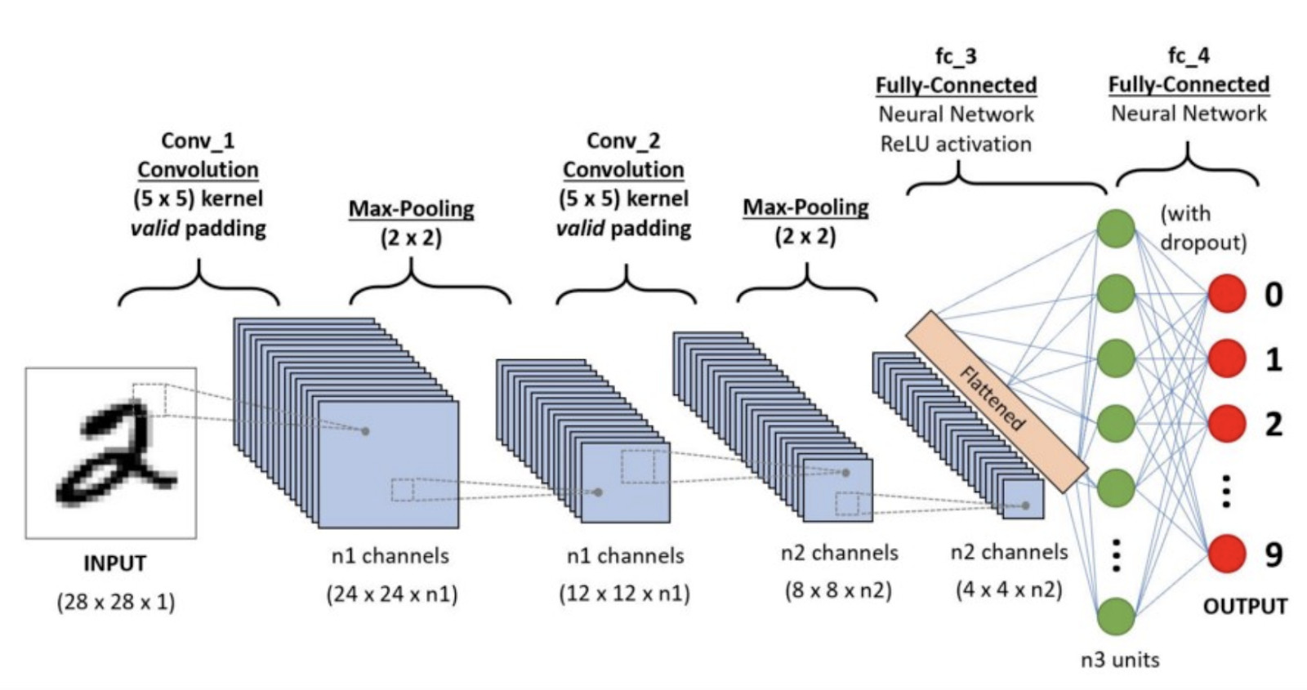
Handwritten Digit Recognition with Convolutional Neural Network
Gaganpreet Kaur
Hood College, Frederick , Maryland
Abstract
Implementation Process
Results
Image recognition requires complex and computationally intensive tasks. Numerous applications demand recognizing images for various purposes such as MRI and X-Ray scans. Images are inherently large; thus, it requires extra computing power to process. As imaging technology advances to capture more data in pixels, image sizes will continue to increase in size. The resulting image will make image processing more cumbersome to process. The image complexity magnifies when there are more patterns to understand and analyze. The goal of this project was to demonstrate deep learning skills. This project uses deep learning to recognize handwritten images from the MNIST (Modified National Institute of Standards and Technology) dataset [2]. Deep learning can help process images efficiently by reducing their complexity and computation time. The problem of recognizing the handwritten digits was processed by the CNN (Convolutional Neural Network) algorithm. The CNN algorithm reached about 99.45% accuracy with a test loss of 1.8%. This paper discusses the solution approach and implementation process to achieve better accuracy.
Handwritten digits were processed by using the CNN algorithm. CNN is one of the most popular deep neural network algorithms. CNN works by taking image data as input, applying convolution processes, generating a fully connected network, and producing an output. The illustration of how CNN works is provided in Fig. 1.
A new model was developed to predict handwritten digits with high accuracy. There are 6 steps taken to achieve better accuracy in this project.
Load and Split Test and Train Images
Preprocess Test and Train images
Setup Neural Network
Network Compilation
Train the network with fit method
Evaluate the network’s performance
Figure 1: Convolutional Neural Network for recognizing handwritten digits.
Source: Adapted from [5]
The model developed for recognizing handwritten digits reached an accuracy of 99.44 percent with a test loss value of .017. It is an optimal solution and it reached above 99 percent. The same can be seen from Fig. 2. It means that this model has correctly identified 9,945 out of 10,000 test images. Only a small portion of images was not identified correctly. The original version of the model achieved an accuracy of 94 percent. However, after tweaking with model layers and epoch size, the accuracy was improved. It was a dramatic improvement in terms of accuracy.
Figure 2: Training and Validation Accuracy
Data Description
The image data of handwritten digits was taken from the Kaggle platform to analyze, model, and make predictions. It is the standard dataset used by data scientists to practice their skills. To prepare the data, it was split into two tuples: test, and train tuple. Each tuple contains labels and dataset elements. The training dataset contained sixty thousand images and the test dataset contained ten thousand images. The handwritten images consist of numbers from 0 to 9 along with multiple variations of each dataset. So, there are 10 classes of a dataset in this project. Each image shape in a dataset has a 2D dimension of 28x28 pixels. Also, each pixel value in an image is an unsigned integer in the range between 0 and 255. The value 0 represents black and 255 represents white.
Future Works
Deep learning is a powerful tool for analyzing large volumes of data and making informed decisions. In this project, the use of the CNN algorithm showed excellent outcomes. The CNN algorithm can also help solve other real-world problems such as analyzing MRI images, finding disease patterns, and identifying earthquakes. These techniques can be further explored to develop a system that can automatically select best strategy to make predictions.
For more detail about this project and source code,
please visit https://github.com/KellyK81/deep-learning
Contact
References
Gaganpreet Kaur
Hood College, Department of Computer Science
Frederick , MD
gk7@hood.edu
[1] S. Karanam, Y. Srinivas, en M. Krishna, “Study on image processing using deep learning techniques”, Materials Today: Proceedings, 10 2020.
[2] “Digit recognizer,” Kaggle. [Online]. Available: https://www.kaggle.com/c/digit-recognizer. [Accessed: 15-Dec-2021].
[3] S. K. Moore, D. Schneider, and E. Strickland, “How deep learning works,” IEEE Spectrum, 29-Sep-2021. [Online]. Available: https://spectrum.ieee.org/what-is-deep-learning. [Accessed: 15-Dec-2021].
[4] E. David, “Council post: How the future of deep learning could resemble the human brain,” Forbes, 10-Nov-2020. [Online]. Available:
https://www.forbes.com/sites/forbestechcouncil/2020/11/11/how-the-future-of-deep-learning-could-resemble-the-human-brain/?sh=1580e9e2415c. [Accessed: 15-Dec-2021].
[5] S. Saha, “A comprehensive guide to Convolutional Neural Networks - the eli5 way,” Medium, 17-Dec-2018. [Online]. Available:
https://towardsdatascience.com/a-comprehensive-guide-to-convolutional-neural-networks-the-eli5-way-3bd2b1164a53. [Accessed: 15-Dec-2021].

